Slide 1
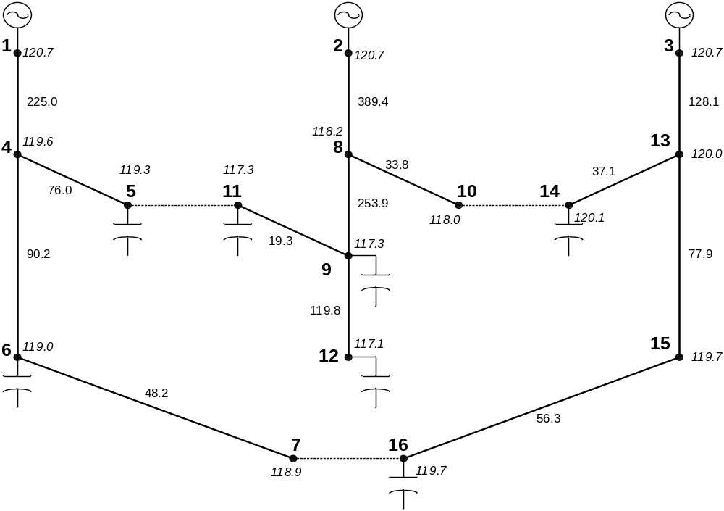
Loss Minimization – Branch Exchange
Branch Exchange
Loop Breaking
Branch & Bound
Heuristics
Optimization
  Genetic Alg.
  Simulated Annealing
  Ant Colony
  Et cetera

Slide 2
New SwtControl Object
SwtControls Attach to any Power Delivery Element
These closed switches create a meshed system with
lowest possible losses.
new swtcontrol.1_4 SwitchedObj=line.1_4 SwitchedTerm=1 Action=c
new swtcontrol.4_5 SwitchedObj=line.4_5 SwitchedTerm=1 Action=c
new swtcontrol.4_6 SwitchedObj=line.4_6 SwitchedTerm=1 Action=c
new swtcontrol.6_7 SwitchedObj=line.6_7 SwitchedTerm=1 Action=c
new swtcontrol.2_8 SwitchedObj=line.2_8 SwitchedTerm=1 Action=c
new swtcontrol.8_9 SwitchedObj=line.8_9 SwitchedTerm=1 Action=c
new swtcontrol.8_10 SwitchedObj=line.8_10 SwitchedTerm=1 Action=c
new swtcontrol.9_11 SwitchedObj=line.9_11 SwitchedTerm=1 Action=c
new swtcontrol.9_12 SwitchedObj=line.9_12 SwitchedTerm=1 Action=c
new swtcontrol.3_13 SwitchedObj=line.3_13 SwitchedTerm=1 Action=c
new swtcontrol.13_14 SwitchedObj=line.13_14 SwitchedTerm=1 Action=c
new swtcontrol.13_15 SwitchedObj=line.13_15 SwitchedTerm=1 Action=c
new swtcontrol.15_16 SwitchedObj=line.15_16 SwitchedTerm=1 Action=c
new swtcontrol.5_11 SwitchedObj=line.5_11 SwitchedTerm=1 Action=c
new swtcontrol.10_14 SwitchedObj=line.10_14 SwitchedTerm=1 Action=c
new swtcontrol.7_16 SwitchedObj=line.7_16 SwitchedTerm=1 Action=c
// Now Open the Three Normally-Open Tie Switches
edit swtcontrol.5_11 action=o
edit swtcontrol.7_16 action=o
edit swtcontrol.10_14 action=o
Traditionally in DSS:
// initially open tie switches
// open line.5_11 1
// open line.7_16 1
// open line.10_14 1

Slide 3

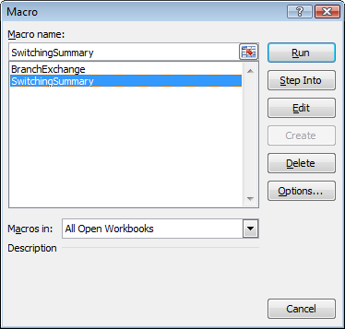
Running Loss Minimization from Excel
Option Explicit
Dim gPath As String
Dim gBase As String
Dim ws As Worksheet
Dim eng As DSS
Dim txt As Text
Dim ckt As Circuit
Dim elem As CktElement
Dim swt As SwtControls
Dim b As bus
Private Sub Preamble()
gPath = Range("DataPath")
gBase = Range("BaseFile")
Set eng = CreateObject("OpenDSSEngine.DSS")
eng.start (0)
Set txt = eng.Text
txt.Command = "clear"
txt.Command = "compile " & gPath & gBase
Set ckt = eng.ActiveCircuit
End Sub

Slide 4
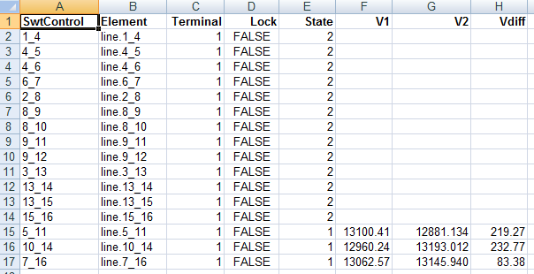
Navigating the SwtControls Interface
Public Sub SwitchingSummary()
Dim i, r As Integer
Dim V1, V2 As Double
Preamble
Set ws = ActiveWorkbook.Worksheets("Switching")
ckt.Solution.Solve
Set swt = ckt.SwtControls
i = swt.First
r = 2

Slide 5
Switching Summary Loop
While i > 0
ws.Cells(r, 1) = swt.name
ws.Cells(r, 2) = swt.SwitchedObj
ws.Cells(r, 3) = swt.SwitchedTerm
ws.Cells(r, 4) = swt.IsLocked
ws.Cells(r, 5) = swt.Action
ws.Cells(r, 6) = ""
ws.Cells(r, 7) = ""
ws.Cells(r, 8) = ""
Set elem = ckt.CktElements(swt.SwitchedObj)
If swt.Action = dssActionOpen Then
V1 = elem.SeqVoltages(1)
V2 = elem.SeqVoltages(4)
ws.Cells(r, 6) = CStr(V1)
ws.Cells(r, 7) = CStr(V2)
ws.Cells(r, 8) = CStr(Abs(V1 - V2))
End If
i = swt.Next
r = r + 1
Wend
End Sub

Slide 6

Branch Exchange Output
Public Sub BranchExchange()
Dim iter, c, r, i As Integer
Dim done As Boolean
Dim Vdiff, Vmax As Double
Dim LastLoss, ThisLoss As Double
Dim ToClose, ToOpen, LowBus As String
Preamble
Set ws = ActiveWorkbook.Worksheets("Switching")
Set swt = ckt.SwtControls
iter = 1
done = False
LastLoss = 1E+99
While Not done
r = iter + 1
ws.Cells(r, 10) = iter
ckt.Solution.Solve
ThisLoss = ckt.Losses(0)
ws.Cells(r, 11) = ThisLoss
ws.Cells(r, 12) = ckt.Topology.NumLoops ' should stay zero

Slide 7
Finding a Switch to Swap (Closed)
Vmax = 0#
ToClose = ""
ToOpen = ""
LowBus = ""
c = 14
i = swt.First
While i > 0 ' find the open switch with biggest delta-V
If swt.Action = dssActionOpen Then
ws.Cells(r, c) = swt.name
Set elem = ckt.CktElements(swt.SwitchedObj)
Vdiff = Abs(elem.SeqVoltages(1) - elem.SeqVoltages(4))
If Vdiff > Vmax Then
Vmax = Vdiff
ToClose = swt.name
LowBus = FindLowBus
End If
c = c + 1
End If
i = swt.Next
Wend
ws.Cells(r, 13) = CStr(Vmax)

Slide 8
Terminating Branch Exchange Loop
done = True ' unless we found a switch pair to exchange
If Len(LowBus) > 0 Then ' make the swap
ToOpen = FindSwitchToOpen(LowBus)
If Len(ToOpen) > 0 Then
swt.name = ToClose
swt.Action = dssActionClose
swt.name = ToOpen
swt.Action = dssActionOpen
done = False ' try again
End If
End If
iter = r
' stop if too many iterations, system is non-radial, or losses go up
If iter > 10 Or ckt.Topology.NumIsolated > 0 Or ThisLoss > LastLoss Then
done = True
End If
LastLoss = ThisLoss
Wend
End Sub

